Slide 1
Chapter 11 Unicast Routing Protocols: RIP, OSPF, and BGP

Slide 2
Outline
Introduction
Intra- and Inter-Domain Routing
Distance Vector Routing
RIP
Link State Routing
OSPF
Path Vector Routing
BGP

Slide 3
Introduction
An internet is a combination of networks connected by routers
How to pass a packet from source to destination ?
Which of the available pathways is the optimum pathway ?
Depends on the metric
Metric: a cost assigned for passing through a network
A router should choose the route with the smallest metric

Slide 4
Introduction (Cont.)
The metric assigned to each network depends on the type of protocol
RIP (Routing Information Protocol)
Treat each network as equal
The cost of passing through each network is the same: one hop count
Open Shortest Path First (OSPF)
Allow administrator to assign a cost for passing through a network based on the type of service required
For example, maximum throughput or minimum delay
Border Gateway Protocol (BGP)
The criterion is the policy, which can be set by the administrator

Slide 5
Introduction (Cont.)
Routing table can be static or dynamic
An internet needs dynamic routing tables
Dynamic routing table is achieved by the routing protocols

Slide 6
Outline
Introduction
Intra- and Inter-Domain Routing
Distance Vector Routing
RIP
Link State Routing
OSPF
Path Vector Routing
BGP

Slide 7
Interior and Exterior Routing
An Internet can be so large
One routing protocol cannot handle the task of updating routing table of all routers
Thus, an Internet is divided into autonomous systems (AS)
AS is a group of networks and routers under the authority of a single administration

Slide 8
Intra- And Interdomain Routing
intradomain routing
Routing inside an autonomous system
Each AS can chose its own intradomain routing protocol
Examples: distance vector and link state
interdomain routing
Routing between autonomous systems
Only one interdomain routing protocol is usually used between ASs
Examples: path vector

Slide 9
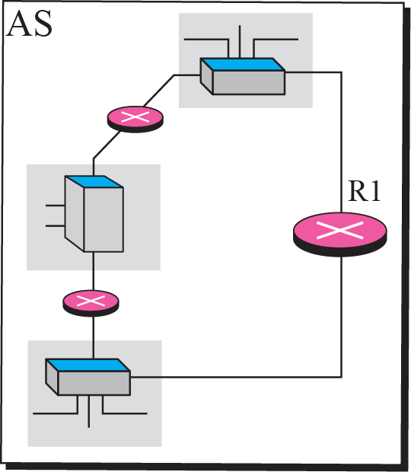
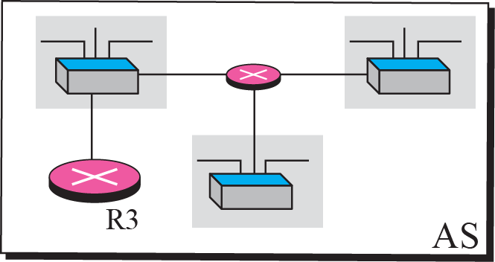
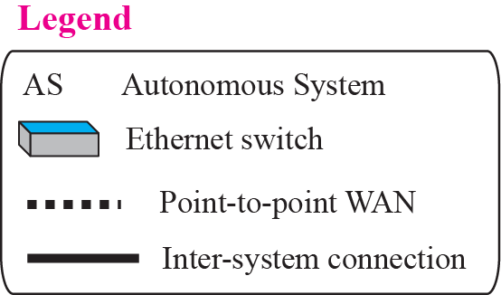
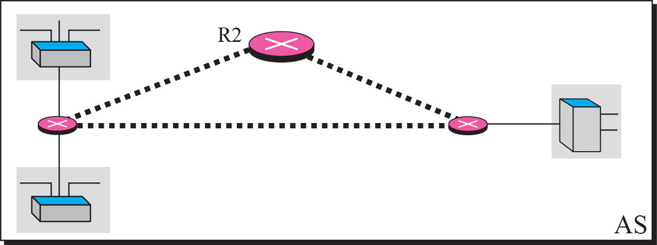
Example: Autonomous Systems

Slide 10
Intradomain Routing Algorithms
Distance-vector routing algorithm
Classical Distributed Bellman-Ford algorithm
RIP (Routing Information Protocol)
Link-state routing algorithm
Centralized version of the shortest path computation
Every router has the whole “picture” of the internet
OSPF (Open Shortest Path First)

Slide 11
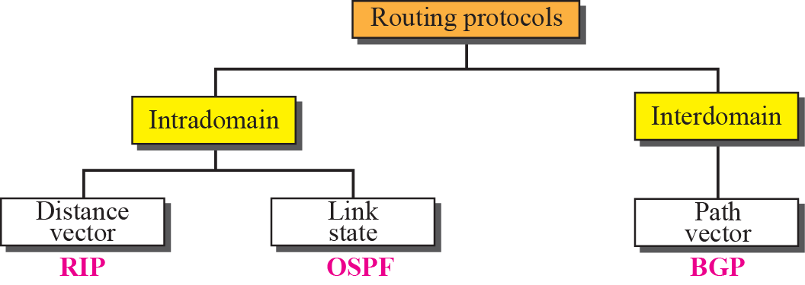
Figure 13-1
Popular Routing Protocols
The McGraw-Hill Companies, Inc., 2000

Slide 12
Outline
Introduction
Intra- and Inter-Domain Routing
Distance Vector Routing
RIP
Link State Routing
OSPF
Path Vector Routing
BGP

Slide 13
Distance Vector Routing
The least cost route between any two nodes is the route with minimum distance.
Each node maintains a vector (table) of minimum distances to every node

Slide 14
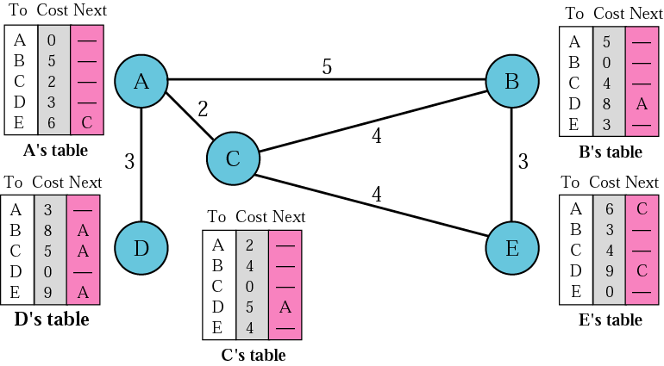
Distance Vector Routing Tables

Slide 15
Initialization
At the beginning
Each node can know only the distance between itself and its immediate neighbors
We assume each node can send a message to the immediate neighbors and find the distance

Slide 16
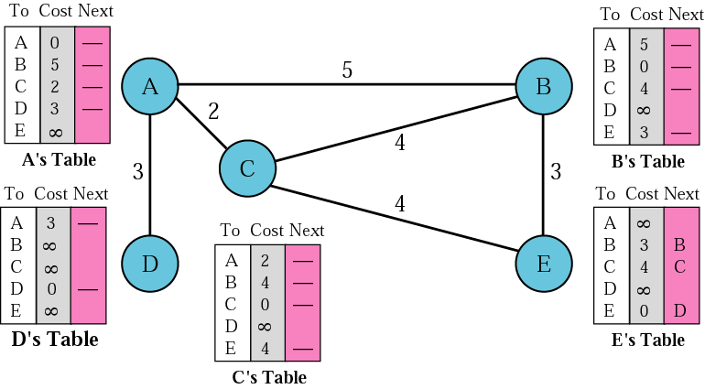
Initialization of Tables in Distance Vector Routing

Slide 17
Sharing
Idea of distance vector routing
Sharing of information between neighbors
In distance vector routing, each node shares its routing table with its immediate neighbors periodically and when there is a change
How much of the table must be shared ?
Send the entire table but contains only the first two columns
The third column must be changed

Slide 18
Updating
Receipt: a two-column table from a neighbor
Add the cost between itself and the sending node to each value in the second column
Repeat the following steps for each advertised destination
If (destination not in the routing table)
Add the advertised information to the table
Else
If (next-hop field is the same)
Replace retry in the table with the new advertised one
Else
If (advertised hop count smaller than one in the table)
Replace entry in the routing table

Slide 19
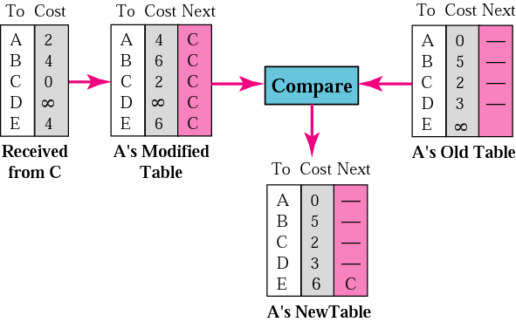
Updating in Distance Vector Routing
Reach A via C

Slide 20
When to Share
The table is sent both periodically and when there is a change in the table
Periodic update
A node sends its routing table in a periodic update
Normally every 30 seconds
Triggered update
A node receives a table from a neighbor resulting in changes in its own table
A node detects some failure in the neighboring links which results in a distance change to infinity

Slide 21
Count to Infinity
A problem with distance vector routing is count to infinity
If a link is broken (cost becomes infinity), every other router should be aware of it immediately
But, in distance vector routing, this takes some time
As a result, distance vector routing has the problem of instability
A network using this protocol can become unstable
Caused by a link has been broken, but routers has not yet known

Slide 22
Two-Node Loop Instability
One example of count to infinity is the two-node loop problem.
See the following table
1. both node A and B know how to reach node X
2. the link between A and X fails
Node A change its table
3a. If node A can send its routing table to B immediately
Everything is fine
3b. However, if node B sends its routing table to A first
Node A assumes that B has found a way to reach X
4. A sends its new update to B and B also update its routing table
5. B sends its new update to A and so on…until the cost reach infinity
6. Then both A and B knows that the link is broken

Slide 23
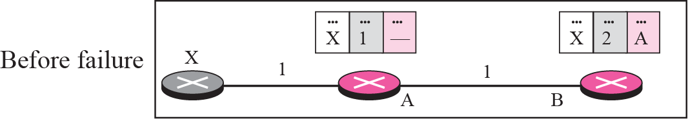
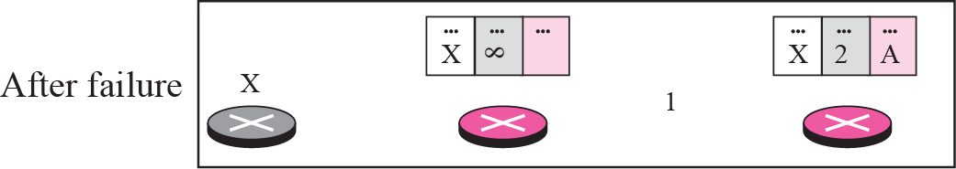
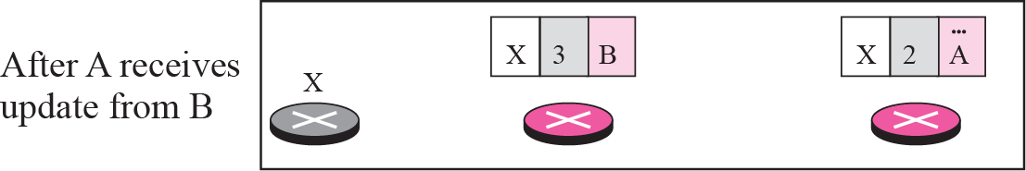
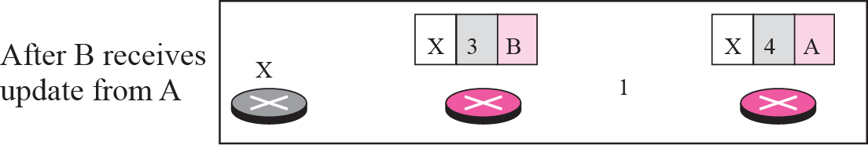
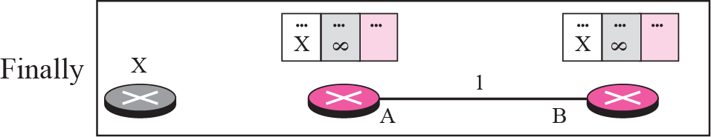
Two-Node Instability
1

Slide 24
Two-Node Loop Instability (Cont.)
As a result, during the time before cost reaches infinity
A packet destined for X bounces between A and B
Create a two-node loop instability
Solutions
Defining infinity
Split horizon
Split horizon and poison reverse

Slide 25
Defining Infinity
Redefine infinity to a smaller number
Shorten the time of instability
Most implementation define the distance between each node to be 1
Define 16 as infinity
As a result
The distance vector scheme cannot be used in large system
The size of network, in each direction, can not exceed 15 hops

Slide 26
Split Horizon
Do not flood the table through each interface and a router must distinguish between different interface
If a router received route updating message from an interface
This same updated information must not be sent back through this interface
Since the information has come from the sending one

Slide 27
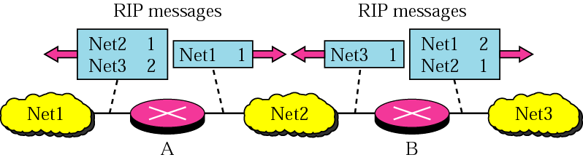
Split Horizon
B receives information about Net1 and Net2 through its left interface
This information is updated and passed on through the right interface but not to the left
The McGraw-Hill Companies, Inc., 2000

Slide 28
Split Horizon (Cont.)
Thus, in the figure of two-node instability
Node B eliminates the last line of its routing table before it sends to A
Node A then keeps the value of infinity as the distance to X
Later when A sends its routing table to B
B then correct its routing table
The system becomes stable after the first update
Both node A and B know that X is not reachable

Slide 29
Split Horizon and Poison Reverse
Drawback of split horizon
Distance vector uses a timer
If there is no news about a route within the time duration
Delete the route
Since Node B eliminates the route to X
Node A cannot decide it is due to split horizon or because B has not received any news about X recently
Solution: Split Horizon and Poison Reverse

Slide 30
Split Horizon and Poison Reverse
A variation of split horizons
Information received is used to update routing table and then passed out to all interface
However, a table entry is set to a metric of infinity as it’s come through and goes out interface are the same
For example
Router B has received information about Net1 and Net2 through its left interface
Thus, it sends information out about Net1 and Net2 with a metric of 16 to its left interface (assume 16 is infinity)

Slide 31
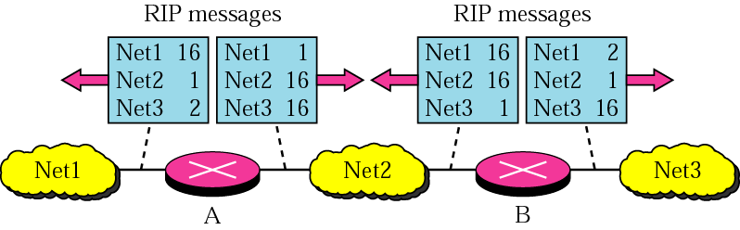
Split Horizon and Poison Reverse
The McGraw-Hill Companies, Inc., 2000

Slide 32
Three-Node Instability
Split Horizon and Poison Reverse cannot solve three-node instability
1. A detects X is not reachable
Sends a packet to B and C
2. B updates its table but the packet to C is lost
3. After a while, C sends to B its routing table
B is fooled and updates its routing table
5. B sends its routing table to A
A is fooled and updates its routing table
6. A then sends its routing table to C, then C to B, and B to A, and so…..
7. The loop continues until the cost reach infinity

Slide 33
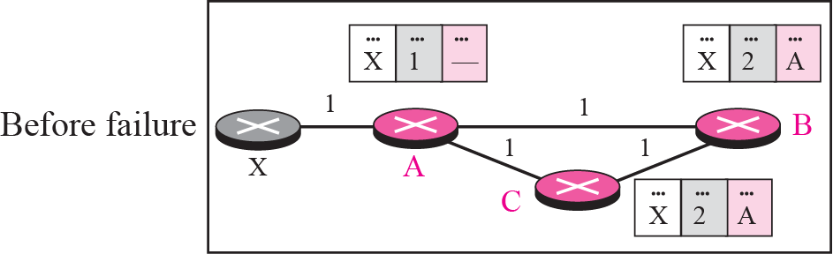
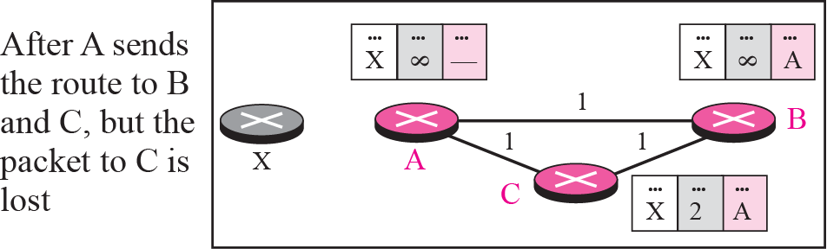
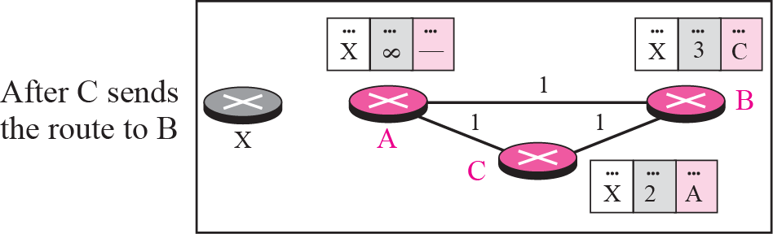
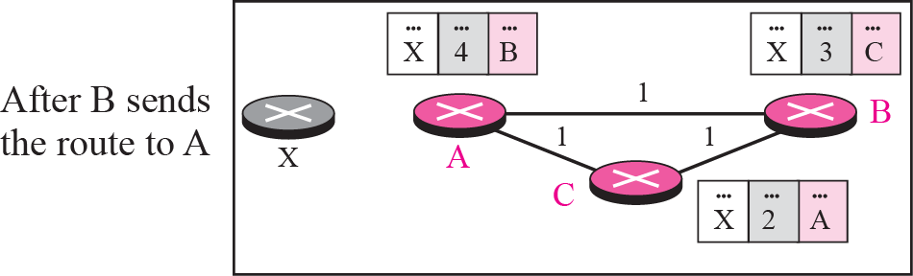
Three-Node Instability

Slide 34
Outline
Introduction
Intra- and Inter-Domain Routing
Distance Vector Routing
RIP (Skip!)
Link State Routing
OSPF
Path Vector Routing
BGP

Slide 35
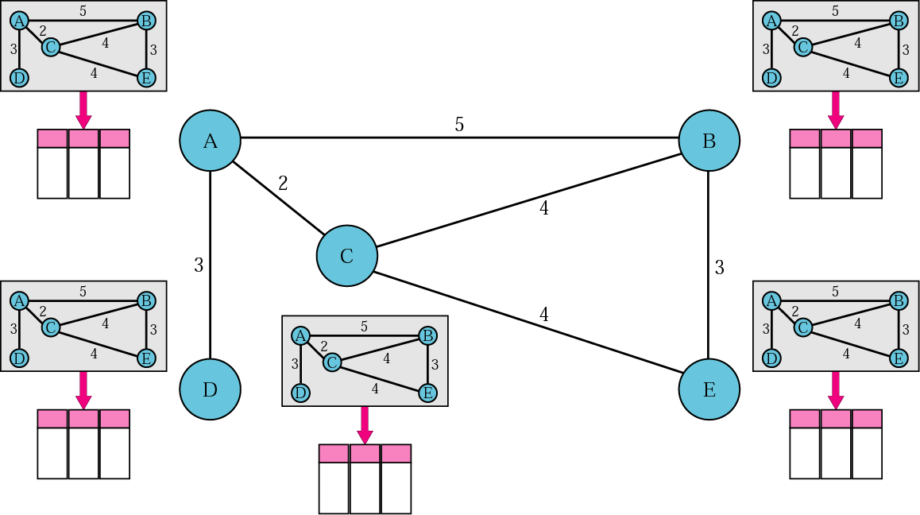
Concept of Link State Routing

Slide 36
Link State Routing
From above Figure
Each node uses the same topology to create a routing table
But the routing table for each node is unique
Like a city map

Slide 37
Link State Routing
Assumption of link state routing
Although the global topology knowledge is not clear and each node has partial knowledge
It knows the state (type, condition, cost) of its link
However, the whole topology can be compiled from the partial knowledge of each node
See the next Figure

Slide 38
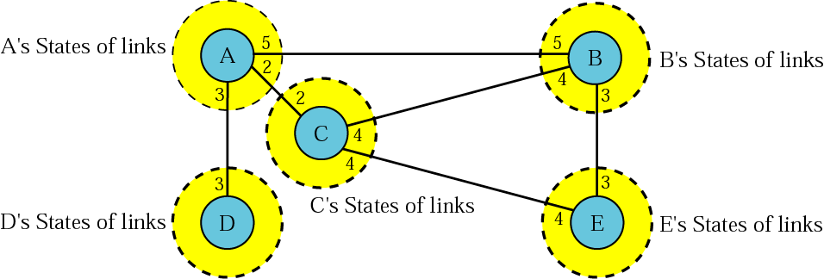
Link State Knowledge
Each node has a partial knowledge of the network
There is an overlap in the knowledge
The overlap guarantees the creation of a common topology
A picture of the whole domain for each node

Slide 39
Building Routing Tables
Four sets of actions in link state routing
Creation of the states of the links by each node
Called the link state packet or LSP
Dissemination of LSPs to every other router, called flooding, in an efficient and reliable way
Formation of a shorten path tree for each node
Calculation of a routing table based on the shortest path tree

Slide 40
Creation of Link State Packet (LSP)
Assume a LSP carries
The node identity
The list of links
Both are needed to make the topology
A sequence number
Distinguishes new LSPs from old ones
Age
Prevent old LSPs from remaining in the domain for a long time

Slide 41
Creation of Link State Packet (LSP)
LSP are generated on two occasions
When there is a change in the topology of the domain
Quickly inform any node to update its topology
On a periodic basis
The period is much longer compared to the distance vector routing
60 minutes or 2 hours

Slide 42
Flooding of LSPs
Flooding: the LSP must be disseminated to all other nodes in the domain
Not only to its neighbors
Rules
The creating node sends a copy of the LSP out of each interface
All receiving nodes compare the incoming one with the copy it may already have
If the newly LSP is older than the one it has by checking sequence number
Discard the LSP
Else
Discard the old LSP
Sends a copy of it out of each interface except the incoming one

Slide 43
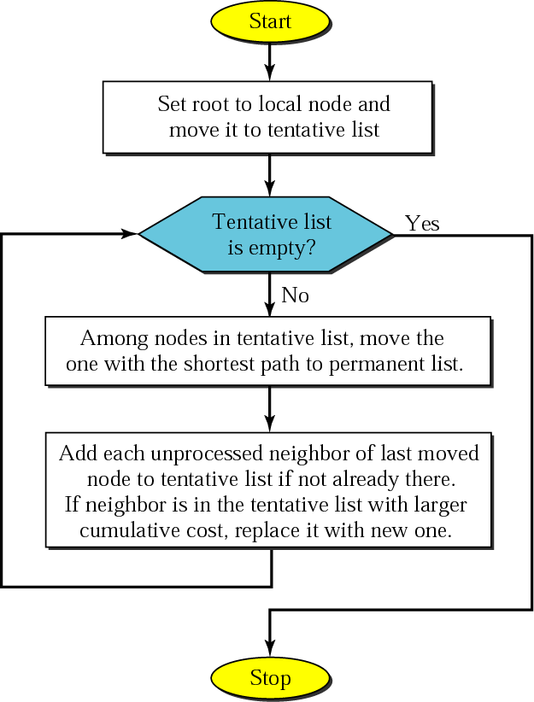
Formation of Shortest Path Tree: Dijkstra Algorithm

Slide 44
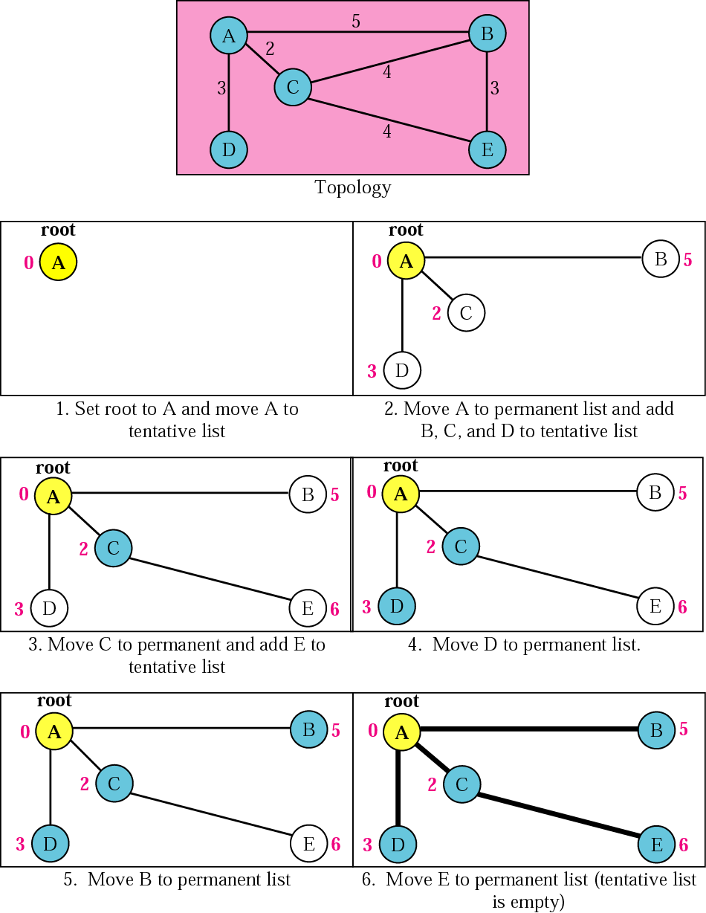
Figure 14.18 Example of formation of shortest path tree

Slide 45
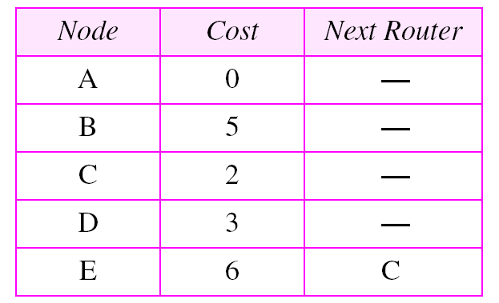
Calculation of Routing Table from Shortest Path Tree
Example:

Slide 46
Outline
Introduction
Intra- and Inter-Domain Routing
Distance Vector Routing
RIP
Link State Routing
OSPF (Skip!)
Path Vector Routing
BGP

Slide 47
Areas
OSPF divides an autonomous system into areas
To handle routing efficiently and in a timely manner
A collection of networks, hosts, and routers all contained within an autonomous system
Thus, an autonomous system can be divided into many different areas
All networks inside an area must be connected

Slide 48
Areas (Cont.)
Routers inside an area flood the area with routing information
At the border of an area, special routers called area border routers
Summarize the information about the area and sent it to other areas

Slide 49
Areas (Cont.)
Among the area inside an autonomous system is a special area called backbone
All of the areas inside an AS must be connected to the backbone
The routers inside the backbone are called the backbone routers
A backbone router can also be an area border router

Slide 50
Areas (Cont.)
If the connectivity between a backbone and an area is broken
A virtual link must be created by the administration
Each area has an area identification
The area identification of the backbone is zero

Slide 51
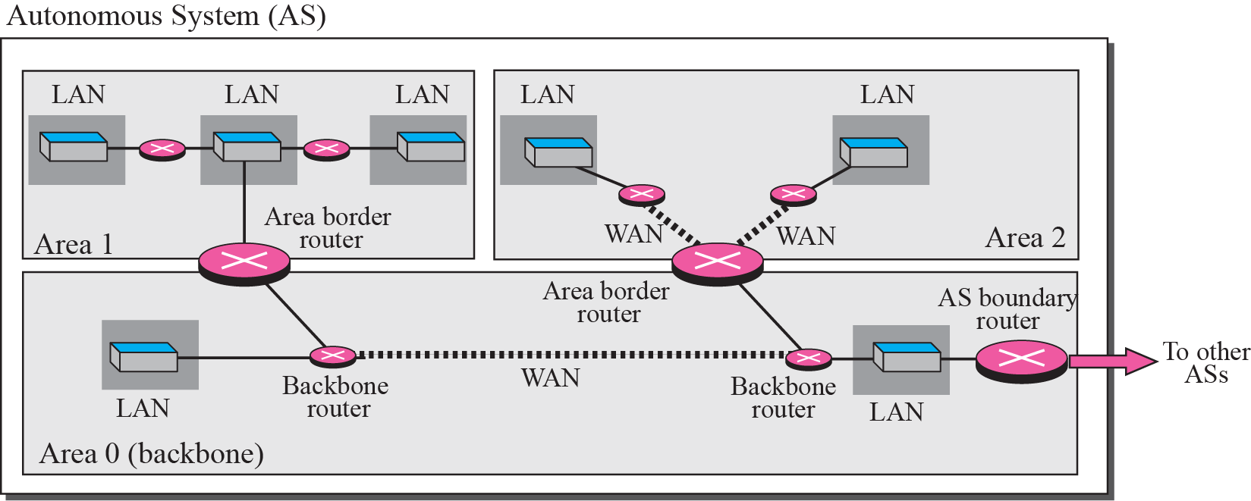
Areas in an Autonomous System
The McGraw-Hill Companies, Inc., 2000

Slide 52
Metrics
OSPF allows the administrator to assign a cost, called the metric, to each route
Metric can be based on a type of service
Minimum delay
Maximum throughput
A router can have multiple routing tables
Each based on a different type of service

Slide 53
Types of Links
In OSPF, a connection is called a link
Four types of links
Point-to-point
Transient
Stub
Virtual

Slide 54
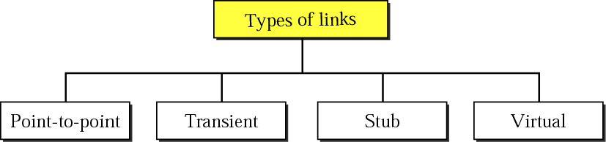
Types of Links
The McGraw-Hill Companies, Inc., 2000

Slide 55
Point-to-Point Link
Connect two routers without any other host or router in these two routers
Example
Telephone line
T-line
Graphically representation
The routers are represented by nodes
The link is represented by a bidirectional edge
The metric
Usually the same at the two ends

Slide 56
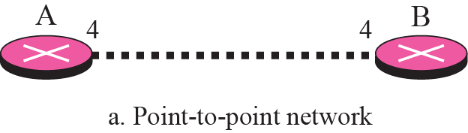
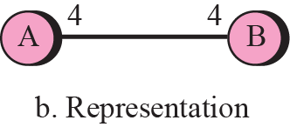
Point-to-Point Link
The McGraw-Hill Companies, Inc., 2000

Slide 57
Transient Link
A network with several routers attached to it
Data can enter through any of the routers and leave through any router
Example
All LANs and some WANs with two or more routers

Slide 58
Transient Link (Cont.)
Graphically representation
Figure b in the next slide. However, it is
Not efficient: each router need to advertise the neighborhood of four other routers
For a total of 20 advertisement
Not realistic: there is no single network (link) between each pair of routers
There should be only one network that serves as a crossroad between all five routers

Slide 59
Transient Link (Cont.)
Reality: each router should be connected to every router through one single network
The network is represented by a node
However, network is not a machine
Cannot function as a router
Solution: one of the routers acts as a single network
This router has a dual purpose: a true router and a designated router
The link is represented as a bidirectional edge
Figure c in the next slide

Slide 60
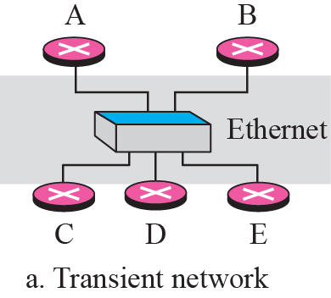
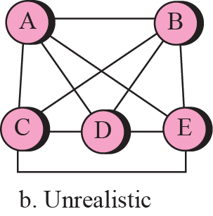
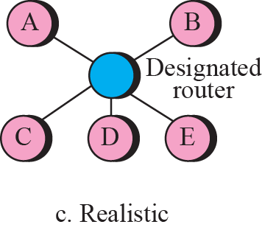
Transient Link
The McGraw-Hill Companies, Inc., 2000

Slide 61
Stub Link
A network that is connected to only one router
Data packet enter and leave through this only one router
A special case of transient network
Graphically representation
The router as a node
The designated router as the network
Note, the link is only one-directional
From the router to the network
Because the network is the end point in the graph representation
See the following third slides

Slide 62
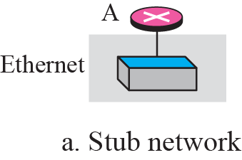
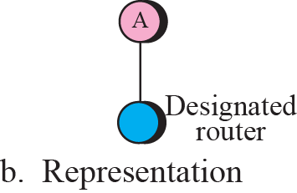
Stub Link
The McGraw-Hill Companies, Inc., 2000

Slide 63
Virtual Link
When the link between two routers is broken
The administrator may create a virtual path between them using a longer path and may go through several routers

Slide 64
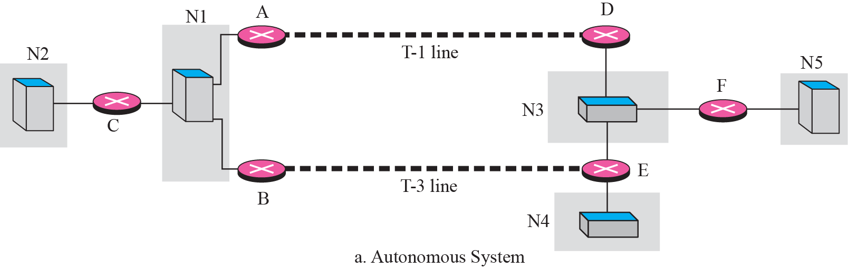
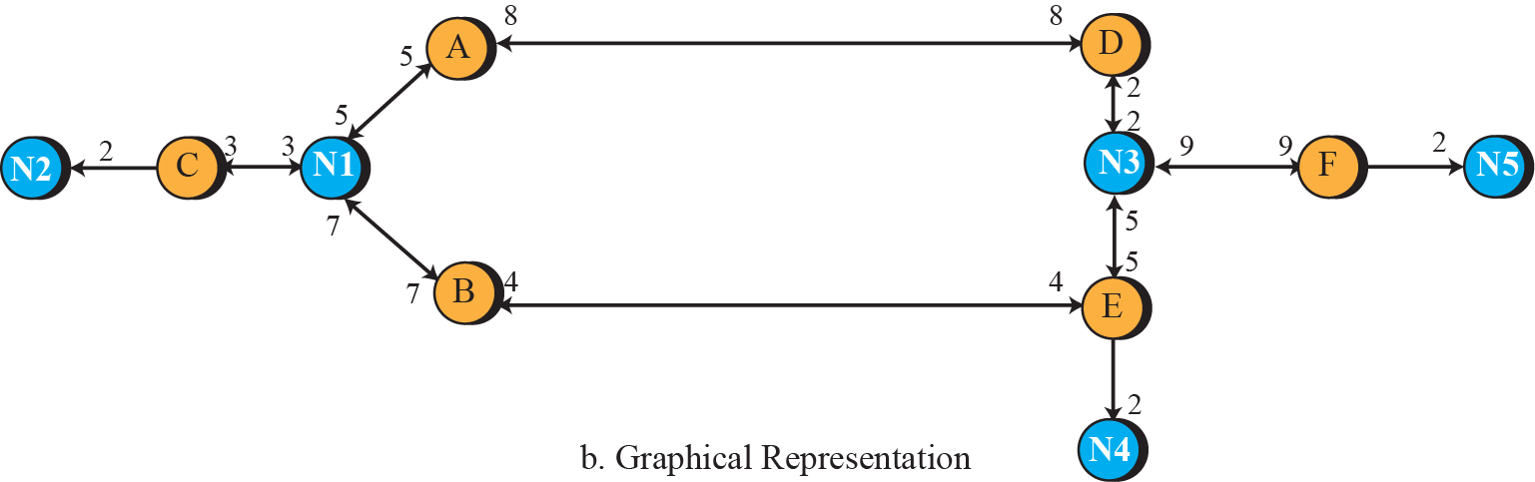
Example of an AS and its graphical representation in OSPF

Slide 65
Types of Packets
OSPF uses five different packets
Hello packet
Database description packet
Link state request packet
Link state update packet
Router link
Network link
Summary link to network
Summary link to AS boundary router
External link
Link state acknowledgment packet

Slide 66
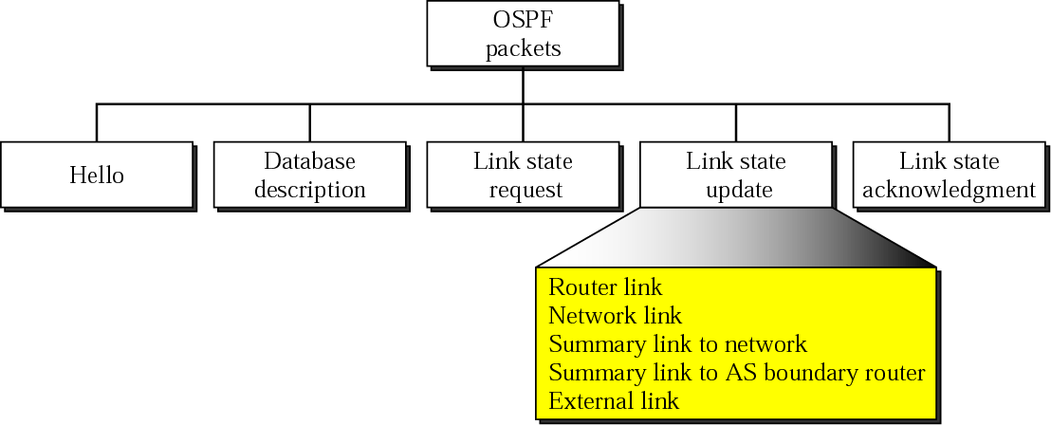
Figure 13-33
Types of OSPF Packets
The McGraw-Hill Companies, Inc., 2000

Slide 67
Router Link LSA
Define the link of a true router
A true router uses this advertisement to announce information about
All of its links
What is at the other side of the links (neighbors)

Slide 68
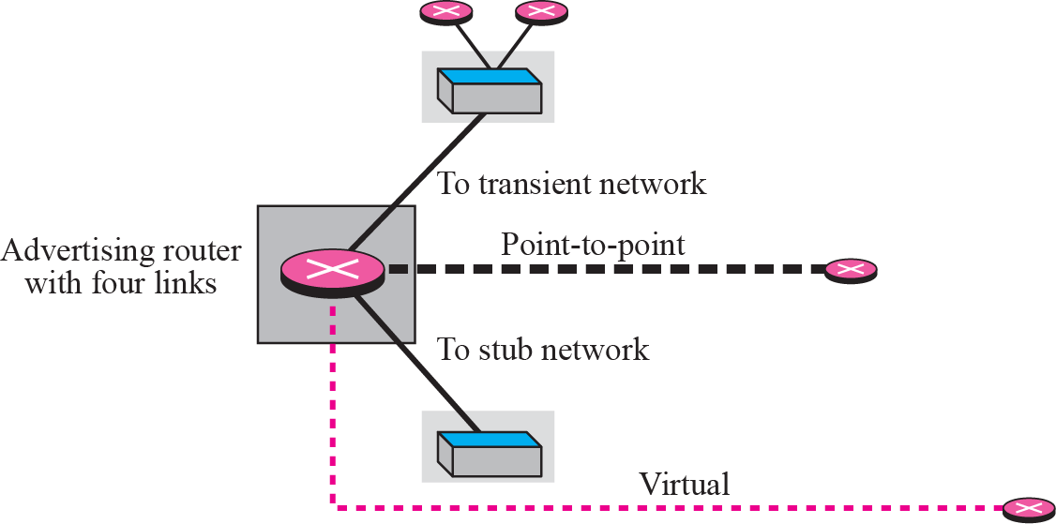
Router Link

Slide 69
Network Link LSA
Define the links of a network
A designated router, on behalf of the transient network, distributes this type of LSA packet
Announce the existence of all of the routers connected to the network
See Next Fig.

Slide 70
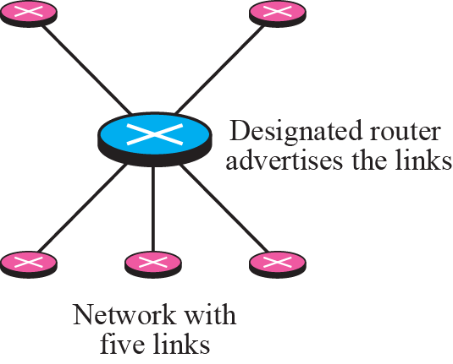
Network Link

Slide 71
Summary Link to Network LSA
Router link and network link advertisements
Flood the area with information inside an area
But a router must also know about the networks outside its area
The area border routers provide this information
An area border router is active in more than one area
Receive router link and network link advertisements
Create a router table for each area
Provide one area’s information to other areas by the summary link to network advertisement

Slide 72
Example
R1 is an area border router and has two routing tables
One for area 1 and one for area 0
R1 will flood area 1 with information about how to reach a network located in area 0
R2 plays the same role

Slide 73
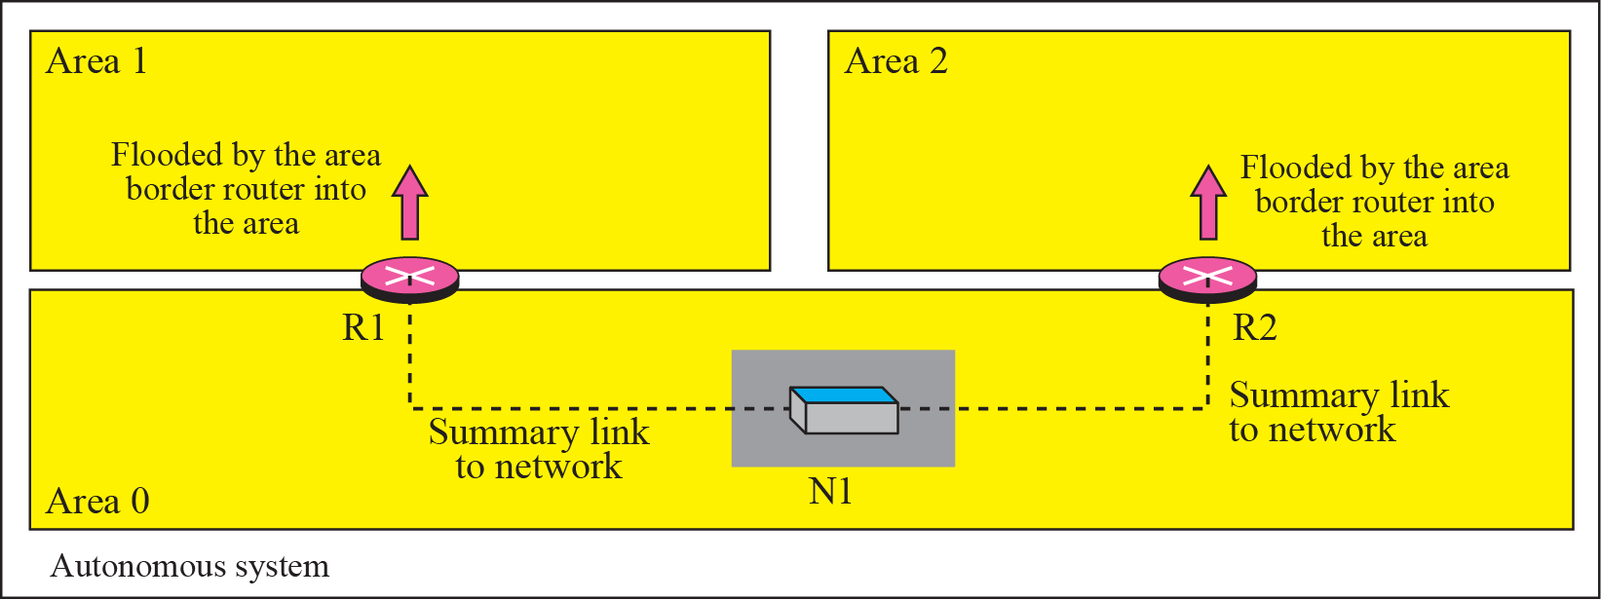
Summary Link to Network

Slide 74
Summary Link to AS Boundary Router LSA
Previous advertisement lets every router know the cost to reach all of the networks inside the AS
But, how to reach a network outside an AS?
A router must know how to reach the autonomous boundary router first
The summary link to AS boundary router provides this information
The area border routers flood their area with this information

Slide 75
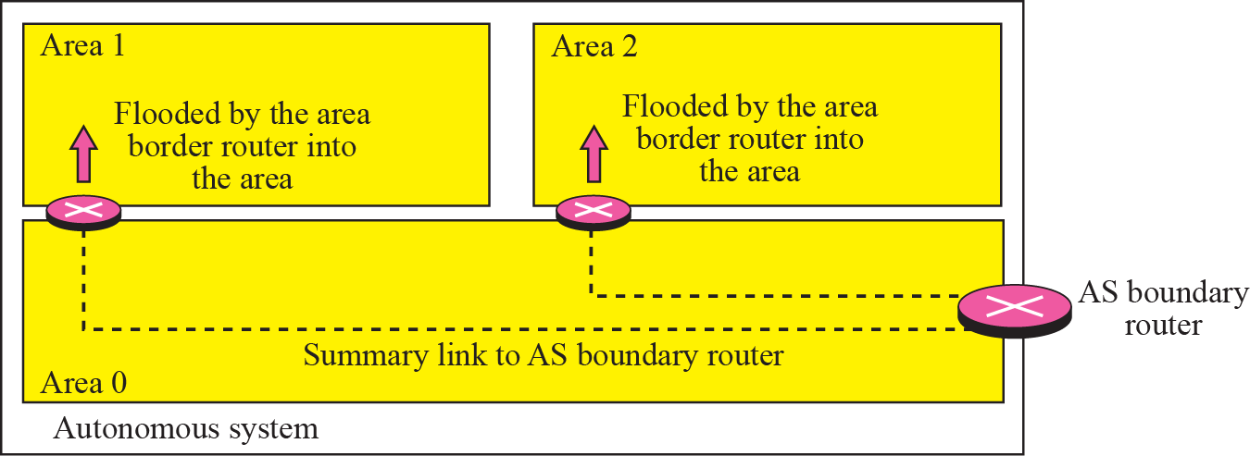
Figure 13-29
Summary Link to AS Boundary Router LSA
The McGraw-Hill Companies, Inc., 2000

Slide 76
Summary Link to AS Boundary Router LSA (Cont.)
Announce the route to an AS boundary router
Define the network to which the AS boundary router is attached
The area border routers flood their area with this LAS

Slide 77
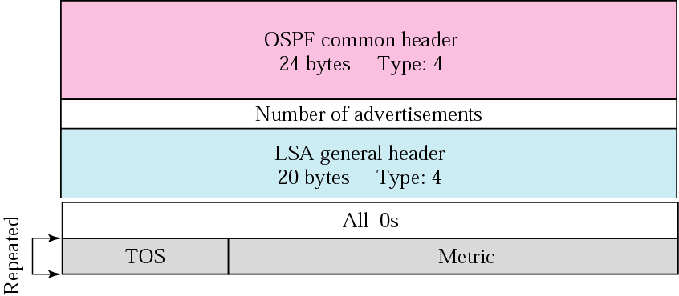
Figure 14.41 Summary link to AS boundary router LSA

Slide 78
External Link LSA
How a router inside an AS know which networks are available outside the AS ?
The external link advertisement provides this information
The AS boundary routers floods the autonomous system with the cost of each network outside the AS
Using a routing table created by an exterior routing protocol
Notably, each advertisement announces one single network
Separate announcements are made if more than one network exists Announce all the networks outside the AS

Slide 79
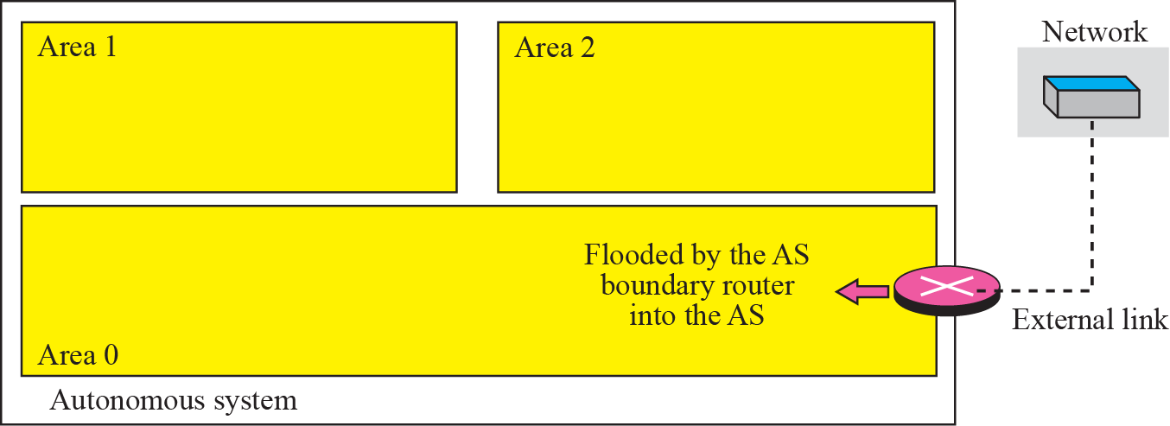
External Link LSA (Cont.)
Use to announce all of the networks outside the AS

Slide 80
Encapsulation
OSPF packets are encapsulated in IP datagram
OSPF contains the acknowledgment mechanism for flow and error control
Doe not need a transport layer protocol to provide these services

Slide 81
Outline
Introduction
Intra- and Inter-Domain Routing
Distance Vector Routing
RIP
Link State Routing
OSPF
Path Vector Routing
BGP

Slide 82
Path Vector Routing
Why distance vector routing and link state routing are not good candidates for interdomain routing?
Mostly because of scalability
Intractable when the domain of operation becomes large

Slide 83
Path Vector Routing (Cont.)
Distance vector routing
Unstable if there is more than a few hops in the domain
Link state routing
An Internet is usually too big for this routing method
Need a huge amount of resources to calculate routing table
Create heavy traffic because of flooding
Solution
Path vector routing

Slide 84
Path Vector Routing (Cont.)
There is one node in each AS to act on behalf of the entire AS
Called it speaker node
The speaker node in an AS
Creates a routing table
Advertises the routing table to speaker nodes in the neighboring ASs
Furthermore, a speaker node advertises the path
Not the metric of the nodes

Slide 85
Initialization
At the beginning, each speaker node can know only the reachability of nodes inside its AS
Example
See the Following 14.48

Slide 86
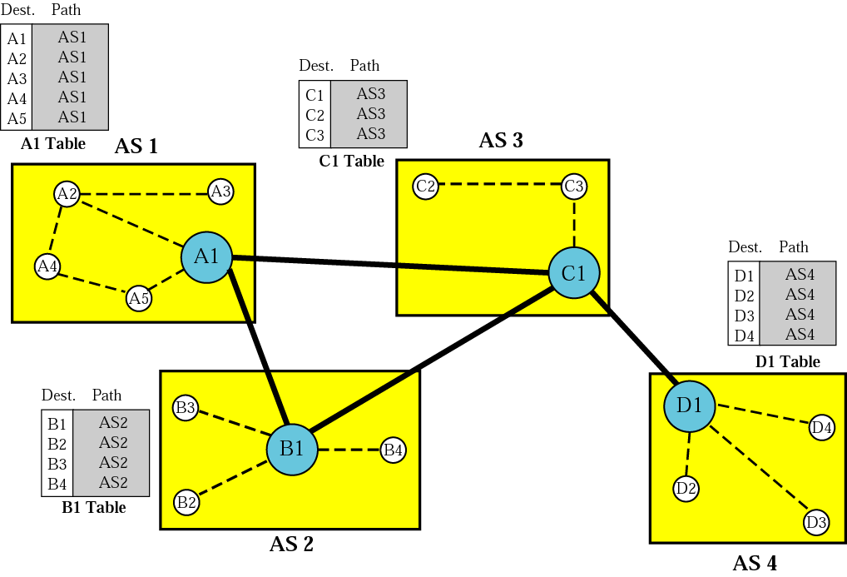
Figure 14.48 Initial routing tables in path vector routing

Slide 87
Sharing
A speaker in an AS share its table with immediate neighbors
Example
In Fig. 14.48
A1 share with B1 and C1

Slide 88
Updating
When a speaker node receives a two-column tables, update its table
Add the nodes that are not in its routing table
Add its own AS and AS that sent the table
Example
Fig. 14.49 shows a stabilized table
If A1 receives a packet for node A3
The path is in AS1 (the packet is at home)
If D1 receives a packet for node A2
The packet should go from AS4 to AS3, and then to AS1

Slide 89
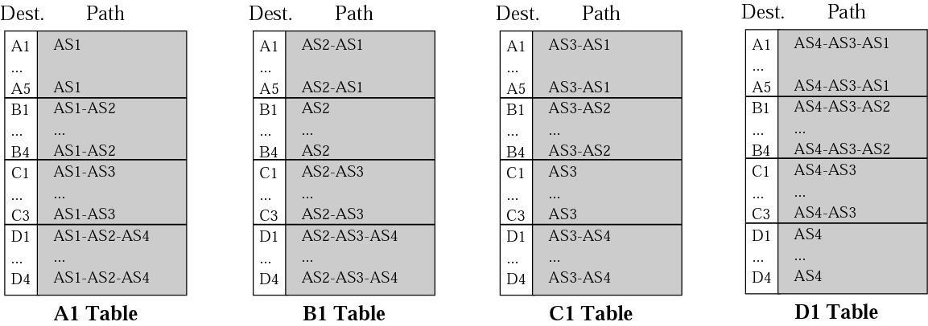
Figure 14.49 Stabilized tables for four autonomous systems

Slide 90
Loop Prevention
Path vector routing can avoid the instability of distance vector routing and the creation of loops
When a router receives a table sent from other node
Check if its AS is in the path list
If yes, looping is involved => ignore the table

Slide 91
Policy Routing
Policy routing can be easily implemented through path vector routing
Path vector routing lists all the ASs of each path
Once a router receives a message, it can check the path.
If one of the AS listed in the path is against its policy,
It can ignore that path and that destination
Does not update its routing table with this path
Does not send this message to its neighbors
Thus, path vector routing are not based on the smallest hop count or the minimum metric
Based on the policy imposed on the router by the administrator

Slide 92
Optimum Path
The optimum path is the path that fits the organization
Criteria may be: hop count, security and safety, reliability
Path vector routing can achieve optimum path by looking for a path best for the organization
Since all the AS are listed in the path

Slide 93
Outline
Introduction
Intra- and Inter-Domain Routing
Distance Vector Routing
RIP
Link State Routing
OSPF
Path Vector Routing
BGP (Skip!)

